Slide 1
Leading the Way
Accor Standing for Children’s Rights in Tourism
Camelia Tepelus

Slide 2
Learning Outcomes
Upon completing the case study, learners will achieve an understanding of the challenges related to issues of child protection in tourism, and be able to explain:
the risks that trafficking and sexual exploitation of children pose to a tourism company;
the factors that should be taken into account when creating a company-wide strategy to prevent sexual exploitation and trafficking; and
how a company can engage with a sensitive and potentially negative phenomenon in a way that will positively contribute to building its corporate sustainability brand.

Slide 3
Background
Accor: leading global hotel operator managing over 3,500 hotels in 92 countries
2012: €5.6 billion revenue, market capitalization €6.7 billion
Multiple award winner of corporate social responsibility and sustainability distinctions (WTTC, Condé Nast Traveler’s, IFTM TOP RESA, Global vision, Voyages-sncf Responsible Tourism Award, etc).
Environmental Department created in 1994, merged into Sustainability Department in 2003.

Slide 4
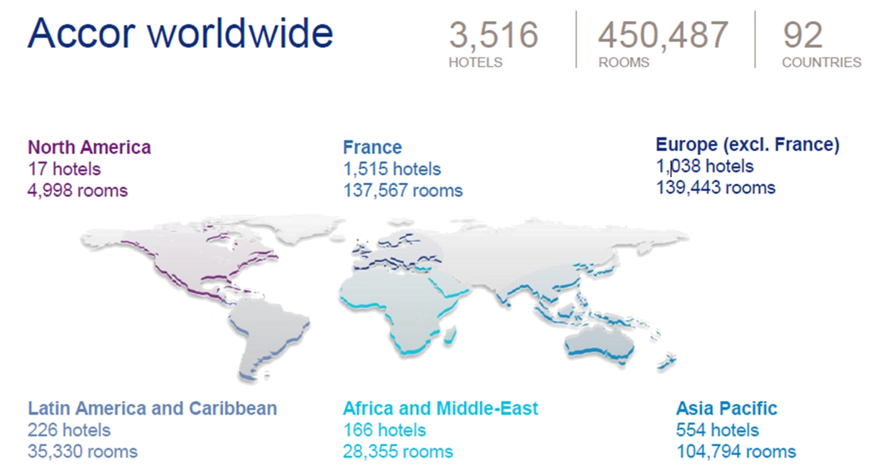
Background

Slide 5
Theoretical fundamentals & legal context
Accor’s commitment to children’s rights in the context of ‘stakeholder theory’ (Clarkson, 1995) supplemented by CSR as ‘a form of strategic investment’ (Porter and Kramer, 2006)
Sexual exploitation of children in tourism (‘child sex tourism’) constitutes a crime under international conventions and national legislations.
There are cultural and social sensitivities around the issue of sexual exploitation of children, which make it very difficult as an issue for tourism businesses.

Slide 6
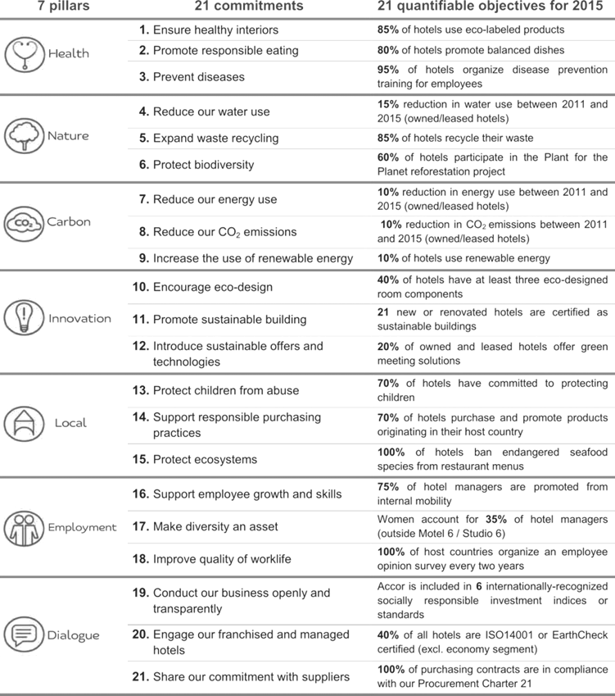
Accor Sustainability Framework
EGO projects
local development, child protection, fighting of epidemics, promoting healthy eating and balanced food; ECO projects reduce water and energy, waste sorting, recycling, biodiversity. Pre-defined measurable targets for all commitments

Slide 7
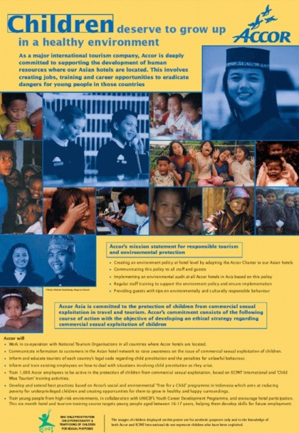
Accor Child Protection Work
In 2002 Accor started to incorporate the protection of children from sexual exploitation into its sustainability strategies, initially for its Asia operations.
Currently the Child-Protection Code of Conduct (TheCode.org) is signed by Accor operations in 36 countries: Cambodia, Indonesia, Laos, Thailand, Vietnam, the Philippines, Romania, Brazil, Argentina, Chile, Colombia, Ecuador, Peru, Uruguay, Dominican Republic, Mexico, Switzerland, Russia, Austria, Hungary, Poland, France and all sub-Saharan countries were the Group is located: Senegal, Burkina Faso, Chad, Benin, Togo, Cameroon, Madagascar, South Africa, Ivory Coast, Ghana, Nigeria, Equatorial Guinea and Guinea Conakry.
Ongoing awareness raising to staff and customers by relaying ECPAT campaigns (films, flyers, posters and publicizing other communication tools).

Slide 8
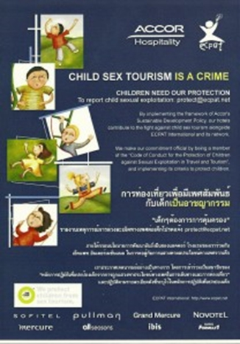
Accor Child Protection Work
Between 2006 and 2011, 70,000 employees were trained to identify cases of sex tourism involving children and to react appropriately.
In 2008, over 11,700 employees were part of the program, and in 2009 13,000 were trained in Asia and Sub-Saharan African countries to detect suspicious behaviours and know how to react, thanks to a global procedure containing all necessary information.
Accor estimates that 49% of all its properties had formally committed to child protection by 2011, while the target for 2015 is set at 70%

Slide 9
Conclusion
Although a very sensitive topic, child protection was seamlessly embedded within the wider Accor group sustainability strategy
A collaborative approach was adopted and promoted consistently by the company, and rewarded in 2010 with a WTTC Global Tourism Business Award

Slide 10
Study Questions
What political and social factors should a company take into consideration when approaching the development of its social sustainability strategy?
In what context should a company assess its risk and exposure to sexual exploitation and trafficking of children?
Discuss, compare and contrast the child sex tourism vulnerability of a destination in Western Europe, compared to a destination in the Caribbean, compared to a destination in South East Asia?
Analyse issues regarding media reports on trafficking or sexual exploitation of children in your region, and make recommendations for the tourism private sector.

